Slide 1


Basic Programming using C++
by Aqilah Rose

Slide 2
“Your best quote that reflects your approach… “It’s one small step for man, one giant leap for mankind.”
- Neil Armstrong

Slide 3
Outline
Introduction
Basic
C++ features
C++
Compiler
First Program
Hello world
Variables &
their types
Data
Types
Operators
in C++
Control Statement
Functions
Functions
in c++
Default
Arguments
C++
Recursion
If, if..else-if
Switch case in C++
Array
For Loop
While Loop
1D N 2D
Passing
Array to fc
C++ Strings
Do While Loop
Continue Statement
Pointers
Break Statement
goto statement
Pointers in C++
this pointer

Slide 4
Outline (Cont.)
Object Oriented Programming (OOP) Concept
OOP Concepts
Constructor
Destructor
Structure
How to Pass & return struct from function
Enumeration
Inheritance
Polymorphism
Function Overloading
Function Overriding
Virtual Function: Run time Polymorphism
Encapsulation
Abstraction
Interfaces-Abstract Class
Pass & Return Obj from Fc
Friend Class & Function

Slide 5
Recap and Additional References
Basic C++ program consists of the following:
Header file
Special statement “using namespace std” (option but highly recommended)
int main {….}
Set of C++ statements within int main () { … } function

Slide 6
Header file
Each of C++ program must have a header file.
Each of header file consists of C++ specific command/function to be used in C++ statement.
Iostream- allows a programmer to use C++ command such as cin and cout and cmath allows a programmer to use C++ math command such as pow, sqrt, exp and many more.
To include C++ header file in a program, you should write the following statement:
#include <iostream>
iostream
cmath
conio
iomanip

Slide 7
Special statement “using namespace std”
To simplify the writing of C++ program. Without this special statement “using namespace std”, you have to write std::cout or std::cin in your C++ program.
You can simply write C++ codes by writing cin or cout in C++ statements.

Slide 8
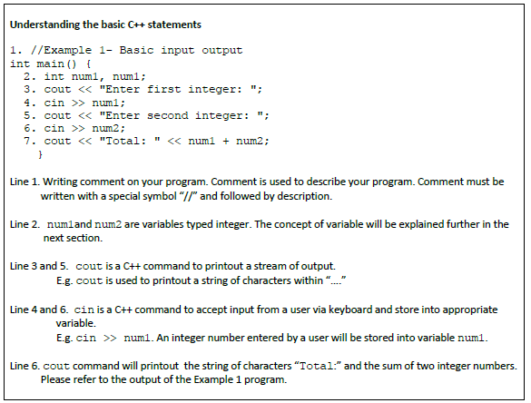

Slide 9
Variable
Variable is required to manipulate or compute data in a C++ program. Each variable is associated with its name and it has a container which allows a programmer to store or retrieve data in C++ program.
There are two types of data type in C++, which are basic data type and advanced data type. Example of basic data types are int, float, double, char, string and bool.
Example of advanced data type is 1-D array, 2-D array, linked list, queue and stack. 1-D array and 2-D array will be explained in the next section while linked list, queue and stack will be explained in Advanced Data Structure course.

Slide 10
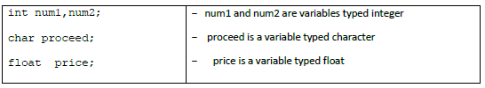
Variable (Cont.)
In a C++ program, variable must be firstly declared before it can be used. You can name the variable with whatever name. However, it’s strongly advice to name the variable with a meaningful name. The following is the example of variable declaration:

Slide 11
Rules of naming variables in C++ program
Variable name should consists only characters, digits, and underscore (“-“)
Variable name must begin with character or underscore
Variable name cannot have two or more split words
Variable is a case sensitive. Upper case and lower-case character are considered differently

Slide 12
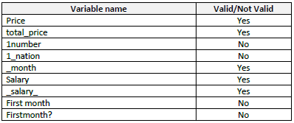
Rules of naming variables in C++ program (Cont.)
If you do not follow the variables naming rules above, C++ compiler will give an error when the program is compiled. The following is the example of valid and not valid variables name:

Slide 13
Concept of assignment in C++ statement
In C++, we must assign a value into a variable using assignment operator “=”. In C++ “assign” means copy the right value of “=” operator and store the value into the left variable of the “=” operator.
Generally, C++ statements in main () function is evaluated from top to bottom
and for each statement in C++ is evaluated from right to left.

Slide 14
C++ Statement is evaluated from right to left
=
Num1
+
Num2;
Total

Slide 15
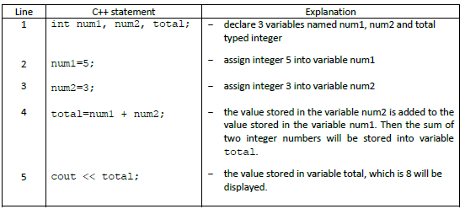

Slide 16
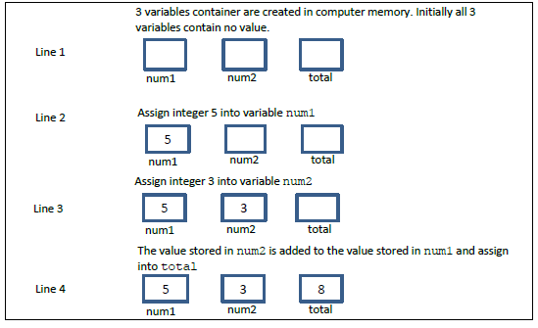
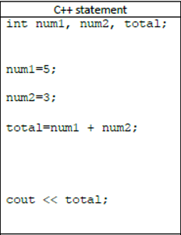
You can imagine the processes of assignment are as follow:
Note: You should relate with C++ statements and its explanation above.

Slide 17
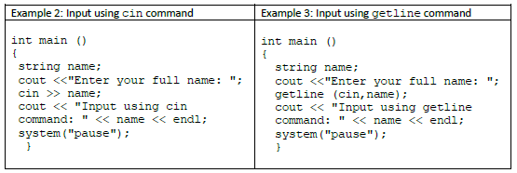
Input
In C++, normally cin or getline is used as input command to accept input from a user typed via keyboard.

Slide 18
Learning experience
Type the program as in the example 2 and example 3, compile and run the program.
Enter your full name. What is the difference between cin and getline command?

Slide 20
Output
Organizing the output of your program in well form is important so that users can use your program and read the output easily. You can set the layout of the output as follows:
to display the output in different line
to align the output from left to the right of the screen
To display the float number with specific decimal number.
To display the output in different line:
use “\n” or “endl” command

Slide 21
Output (Cont.)
(ii) To align the output from left to the right of the screen:
To align the output means that you can shift the output from left to the right of the screen.
You can use “\t” command.
Another option is you can also use cout.width(n)command. n is an integer number which specifies the position the output on the screen.
The program in example 4 uses “\n”, “endl”, “\t” and cout.width(n)command.

Slide 22
Learning experience 3
Type the program as in the example 4, compile and run the program. You should learn based your experience through practical and your observation. Try to relate with the basic output command with the program output after running the program

Slide 23
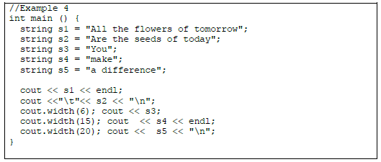

Slide 24
Float Number
(iii) Display the float number with specific decimal number:
To set decimal number you should:
include C++ header file: “include <iomanip>” in a program
use command fixed, showpoint and setprecision(n).
n is an integer number to specify the number of decimal point.
For example: cout <<fixed << showpoint << setprecision(2). Set the output to display 2 decimal points.

Slide 25
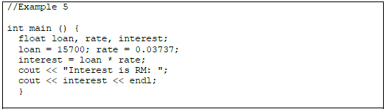

Slide 26
Learning experience 5
Type the program as in example 5, compile and run the program. What is the output?. How to display interest with 2 decimal points only?
Modify your program above by adding the following command
cout << fixed << showpoint << setprecision(2);
after the statement “interest = loan * rate;”. Compile and run the program again. Now, what is the output?
Modify your program again to set the display format with 1 or 4 decimal number.

Slide 27
Understanding errors
Commonly, there are 3 types of program errors. There are:
Syntax error
Logic error
Execution error

Slide 28
Syntax errors
Syntax error occurs due to incorrect uses of programming language command or rule. Syntax error can easily be detected. A compiler normally can detect the error when a program is compiled. A good compiler can show and identify which line in the program has error. E.g. Dev C++ compiler. Example of syntax errors are:
no semicolon “;” at the end of C++ statement
use command cout or cin without include C++ header file <iostream>
use variable without declaration
typo error. E.g. Cout, Cin, c0ut.
incorrect use of command in C++ statement. E.g. a * b = c; it should be c = a * b;
You will not succeed to compile a program with syntax errors. Therefore, you should correct all the syntax errors found in your program.

Slide 29
Logic error (also known as design error/semantic errors)
Logic error occurs due to lack of logical thinking of a programmer. Logical error may arise from analysis or design phase in the problem-solving method. Normally, logic error is difficult to detect by a compiler.
You can compile your program without any syntax errors. However, your program produces incorrect output as expected. Examples of logic errors are:
C++ statements are not arranged in a proper sequence
apply incorrect formula in C++ statement.
logic operator is not used correctly

Slide 30
Execution error
Execution error occurs while you run a program. Normally, a compiler cannot detect execution errors. Examples of execution errors are:
when there is a C++ statement divides integer number with zero
looping error. E.g. infinite loop.

Slide 31
Learning experience 6
This program in example 6 is written to compute BMI index of a person. The program will accept 2 inputs from a user then compute BMI index and finally display the BMI index of a person.
Formula: bmi = weight (in kg)/height^2 (in meter)
Referring to Example 6, what types of the errors exist in the program?
Type and compile the program. Identify those errors and errors message.
Correct all the errors, compile again and run the program.

Slide 32
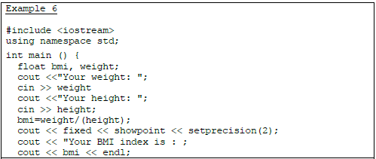
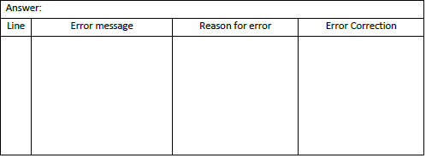

Slide 33
Operator represents an action. For example + is an operator that represents addition. An operator works on two or more operands and produce an output.
For example 3+4+5 here + operator works on three operands and produce 12 as output.
1) Basic Arithmetic Operators 2) Assignment Operators 3) Auto-increment and Auto-decrement Operators 4) Logical Operators 5) Comparison (relational) operators 6) Bitwise Operators 7) Ternary Operator

Slide 34
Control Statement
Control Statement
If, if..else-if
Switch case in C++
For Loop
While Loop
Do While Loop
Continue Statement
Break Statement
goto statement

Slide 35
If else Statement in C++
Sometimes we need to execute a block of statements only when a particular condition is met or not met. This is called decision making, as we are executing a certain code after making a decision in the program logic. For decision making in C++, we have four types of control statements (or control structures), which are as follows:
if statement
nested if statement
if-else statement
if-else-if statement

Slide 36

If statement in C++
If statement consists a condition, followed by statement or a set of statements as
shown below:

Slide 37
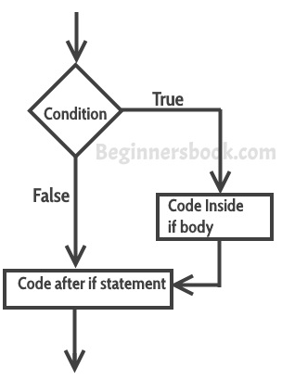
How If statement work?
The statements inside if parenthesis (usually referred as if body) gets executed only when the given condition is true. If the condition is false then the statements inside if body are completely ignored.

Slide 38
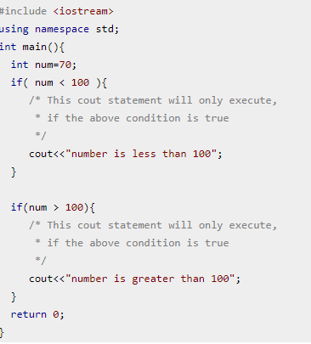
Example If statement

Slide 39
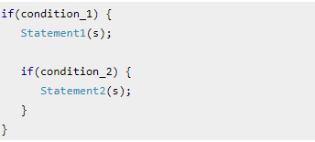
Nested if statement in C++
When there is an if statement inside another if statement then it is called the nested if statement. The structure of nested if looks like this:
Statement1 would execute if the condition_1 is true. Statement2 would only execute if both the conditions( condition_1 and condition_2) are true.

Slide 40
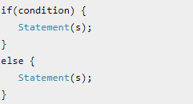
If else statement in C++
Sometimes you have a condition and you want to execute a block of code if condition is true and execute another piece of code if the same condition is false. This can be achieved in C++ using if-else statement.
The statements inside “if” would execute if the condition is true, and the statements inside “else” would execute if the condition is false.
This is how an if-else statement looks:

Slide 41
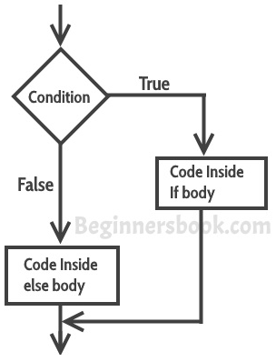

Slide 42
if-else-if Statement in C++
if-else-if statement is used when we need to check multiple conditions.
Note: The most important point to note here is that in if-else-if, as soon as the condition is met, the corresponding set of statements get executed, rest gets ignored. If none of the condition is met then the statements inside “else” gets executed.

Slide 43
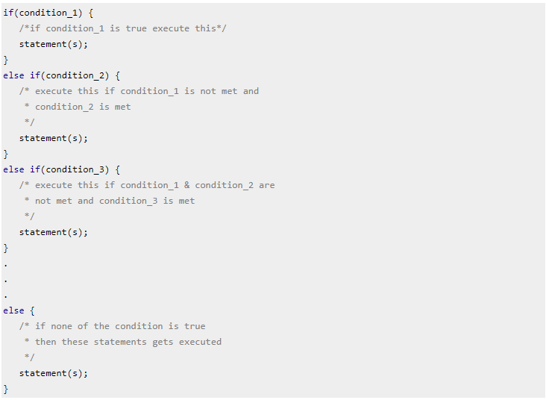
In this control structure we have only one “if” and one “else”, however we can have multiple “else if” blocks.

Slide 44
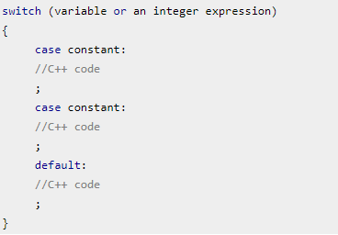
Switch case statement in C++ with example
Switch case statement is used when we have multiple conditions and we need to perform different action based on the condition.
In such case either we can use lengthy if..else-if statement or switch case.
The problem with lengthy if..else-if is that it becomes complex when we have several conditions. The switch case is a clean and efficient method of handling such scenarios.

Slide 45
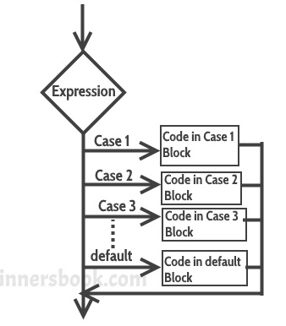
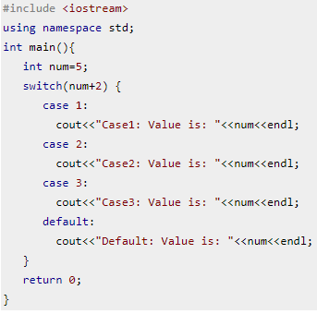

Slide 46
How switch case work?
Explanation: In switch I gave an expression, you can give variable as well. I gave the expression num+2, where num value is 5 and after addition the expression resulted 7.
Since there is no case defined with value 4 the default case got executed.
It evaluates the value of expression or variable (based on whatever is given inside switch braces), then based on the outcome it executes the corresponding case.

Slide 47

For loop in C++
A loop is used for executing a block of statements repeatedly until a particular condition is satisfied. For example, when you are displaying number from 1 to 100 you may want set the value of a variable to 1 and display it 100 times, increasing its value by 1 on each loop iteration.
In C++ we have three types of basic loops: for, while and do-while. In this tutorial we will learn how to use “for loop” in C++.
Syntax of for loop

Slide 48
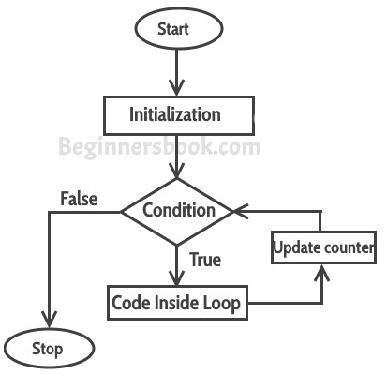
Flow of Execution of the for Loop
As a program executes, the interpreter always keeps track of which statement is about to be executed. We call this the control flow, or the flow of execution of the program.

Slide 49
Flow of Execution of the for Loop (Cont.)
First step: In for loop, initialization happens first and only once, which means that the initialization part of for loop only executes once.
Second step: Condition in for loop is evaluated on each loop iteration, if the condition is true then the statements inside for for loop body gets executed. Once the condition returns false, the statements in for loop does not execute and the control gets transferred to the next statement in the program after for loop.
Third step: After every execution of for loop’s body, the increment/decrement part of for loop executes that updates the loop counter.
Fourth step: After third step, the control jumps to second step and condition is re-evaluated.
The steps from second to fourth repeats until the loop condition returns false.

Slide 50
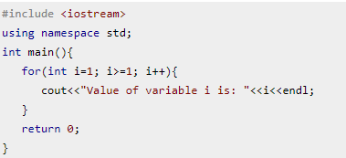
Infinite for loop in C++
A loop is said to be infinite when it executes repeatedly and never stops. This usually happens by mistake. When you set the condition in for loop in such a way that it never return false, it becomes infinite loop.
This is an infinite loop as we are incrementing the value of i so it would always satisfy the condition i>=1, the condition would never return false.

Slide 51
While loop in C++ with example
In while loop, condition is evaluated first and if it returns true then the statements inside while loop execute, this happens repeatedly until the condition returns false.
When condition returns false, the control comes out of loop and jumps to the next statement in the program after while loop.
Note: The important point to note when using while loop is that we need to use increment or decrement statement inside while loop so that the loop variable gets changed on each iteration, and at some point condition returns false. This way we can end the execution of while loop otherwise the loop would execute indefinitely.

Slide 52
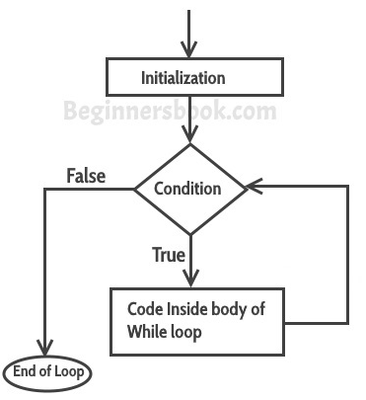
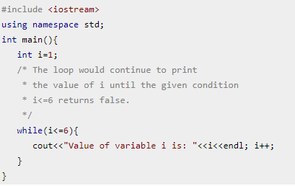
While loop in C++ with example (Cont.)

Slide 53
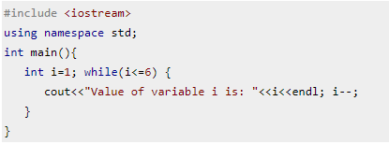
Infinite While loop
A while loop that never stops is said to be the infinite while loop, when we give the condition in such a way so that it never returns false, then the loops becomes infinite and repeats itself indefinitely.
An example of infinite while loop: This loop would never end as I’m decrementing the value of i which is 1 so the condition i<=6 would never return false.

Slide 54
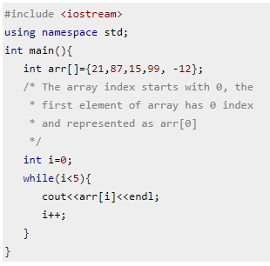
Example: Displaying the elements of array using while loop

Slide 55
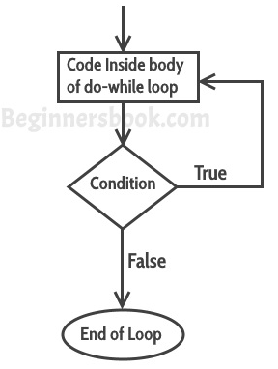
do-while loop in C++ with example
do-while loop is similar to while loop, however there is a difference between them: In while loop, condition is evaluated first and then the statements inside loop body gets executed, on the other hand in do-while loop, statements inside do-while gets executed first and then the condition is evaluated.
First, the statements inside loop execute and then the condition gets evaluated, if the condition returns true then the control jumps to the “do” for further repeated execution of it, this happens repeatedly until the condition returns false. Once condition returns false control jumps to the next statement in the program after do-while.

Slide 56
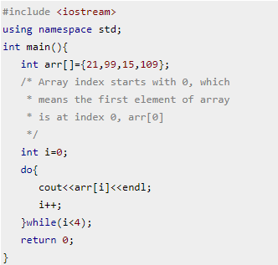
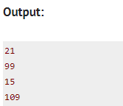
Example: Displaying array elements using do-while loop
Here we have an integer array which has four elements. We are displaying the elements of it using do-while loop

Slide 57
Continue Statement in C++ with example
Continue statement is used inside loops.
Whenever a continue statement is encountered inside a loop, control directly jumps to the beginning of the loop for next iteration, skipping the execution of statements inside loop’s body for the current iteration.

Slide 58
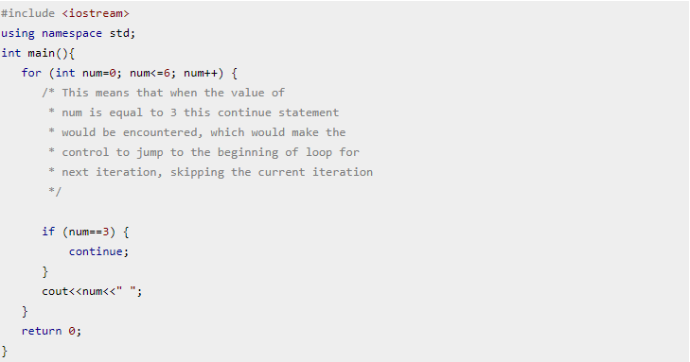
Example: continue statement inside for loop
As you can see that the output is missing the value 3, however the for loop iterate though the num value 0 to 6.
This is because we have set a condition inside loop in such a way, that the continue statement is encountered when the num value is equal to 3.
So for this iteration the loop skipped the cout statement and started the next iteration of loop.

Slide 59
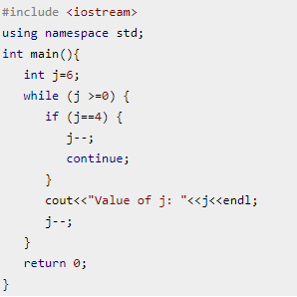
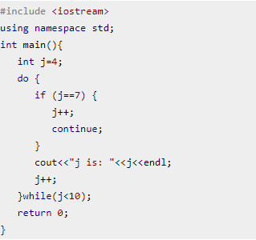
Example: Use of continue in While loop
Example of continue in do-While loop

Slide 60
Break statement
The break statement is used in following two scenarios:
a) Use break statement to come out of the loop instantly. Whenever a break statement is encountered inside a loop, the control directly comes out of loop terminating it. It is used along with if statement, whenever used inside loop so that it occurs only for a particular condition.
b) It is used in switch case control structure after the case blocks. Generally all cases in switch case are followed by a break statement to avoid the subsequent cases (see the example below) execution. Whenever it is encountered in switch-case block, the control comes out of the switch-case body.

Slide 61
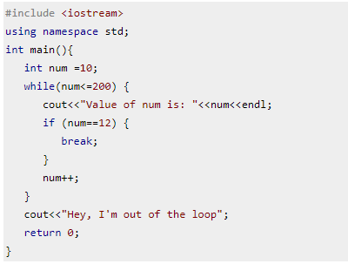
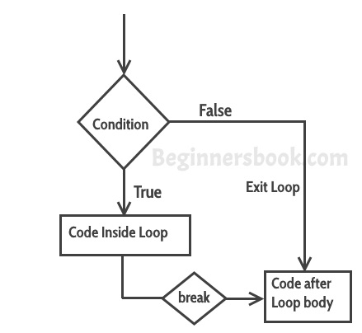
Example: break statement in Switch Case
– Use of break statement in a while loop
Break statement workflow

Slide 62
In the example before, we have a while loop running from 10 to 200 but since we have a break statement that gets encountered when the loop counter variable value reaches 12, the loop gets terminated and the control jumps to the next statement in program after the loop body.

Slide 63
Why didn’t I use break statement after default?
The control would itself come out of the switch after default so I didn’t use break statement after it, however if you want you can use it, there is no harm in doing that
Case doesn’t always need to have order 1, 2, 3 and so on. It can have any integer value after case keyword. Also, case doesn’t need to be in an ascending order always, you can specify them in any order based on the requirement.
Nesting of switch statements are allowed, which means you can have switch statements inside another switch. However nested switch statements should be avoided as it makes program more complex and less readable.

Slide 64
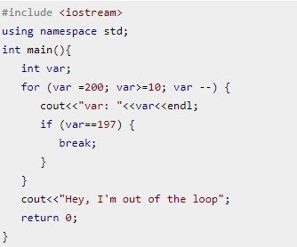
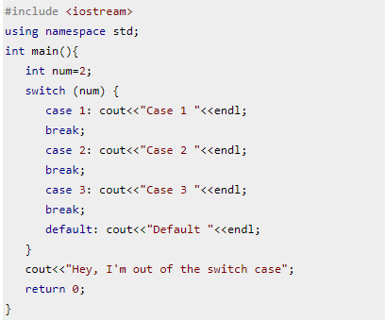
Example: break statement in for loop
Example: break statement in Switch Case

Slide 65
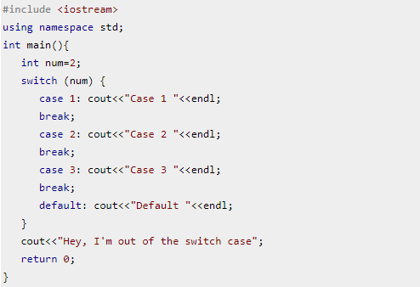
Try it: what happen when there is no break?

Slide 66
goto statement in C++ with example
The goto statement is used for transferring the control of a program to a given label. The syntax of goto statement looks like this:
goto label_name;
In a program we have any number of goto and label statements, the goto statement is followed by a label name, whenever goto statement is encountered, the control of the program jumps to the label specified in the goto statement.
goto statements are almost never used in any development as they are complex and makes your program much less readable and more error prone. In place of goto, you can use continue and break statement.

Slide 67
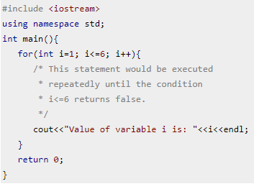
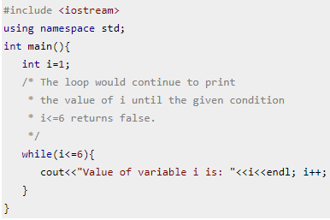
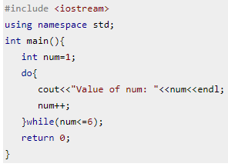
Difference between for, while and do..while loop
For loop
While loop
Do while loop

Slide 68

What can you relate with Computational Thinking?
Computational thinking is the process of approaching a problem in a systematic manner and creating and expressing a solution such that it can be carried out by a computer. But you don't need to be a computer scientist to think like a computer scientist!

Slide 69
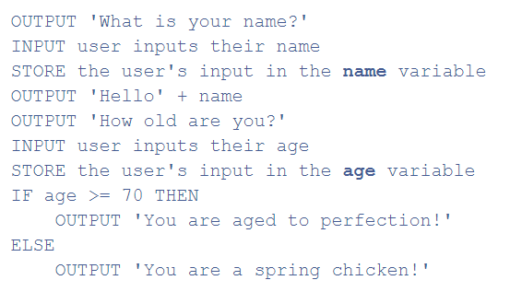
Bitesize explains of two main ways to represent an algorithm: Pseudocode and flowcharts.
Using Pseudocode is similar to “writing in a programming language” and might look something like this:

Slide 70
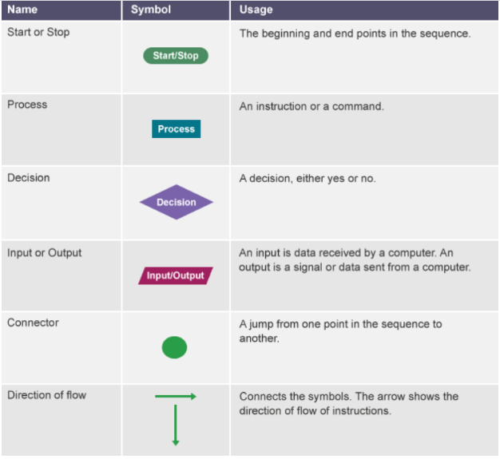
Flowchart on the other hand is a diagram that represents a set of instructions using standard symbols such as these:

Slide 71
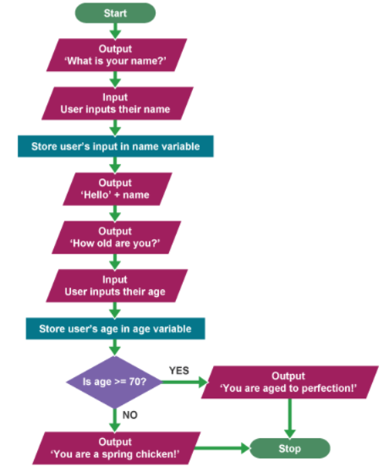
An example of using a flowchart would be making a program to ask people their name and age.

Slide 72
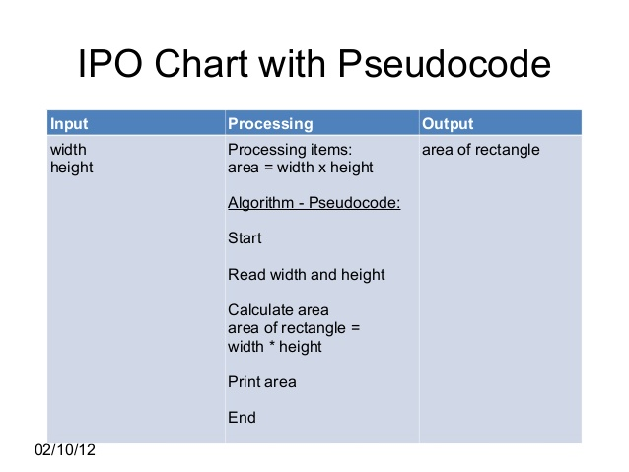
An example of using a pseudocode to calculate area of a rectangle

Slide 73
Class Activity
1. Write a program in C++ to calculate the area of a rectangle. (ask user)
2. From what have you learned, create a program that combine the module in basic and control statement. Be creative!

Slide 74
Functions
Functions
Functions
in c++
Default
Arguments
C++
Recursion

Slide 75
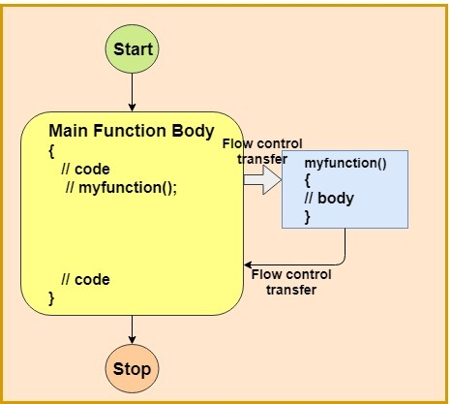

Slide 76
What is function?
A function is block of code which is used to perform a particular task, for example let’s say you are writing a large C++ program and in that program you want to do a particular task several number of times, like displaying value from 1 to 10, in order to do that you have to write few lines of code and you need to repeat these lines every time you display values.
Another way of doing this is that you write these lines inside a function and call that function every time you want to display values. This would make you code simple, readable and reusable.

Slide 77
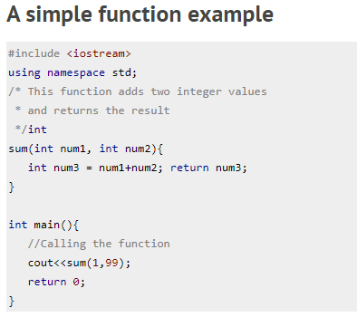

Syntax Functions

Slide 78
Function Declaration
The same program can be code in two ways:
The thing is that when you define the function before the main() function in your program then you don’t need to do function declaration
if you are writing your function after the main() function like we did in the second program then you need to declare the function first, else you will get compilation error.

Slide 79
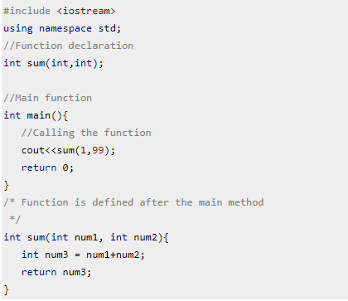
Why do you think we need this f(x) declaration?
Before main()
after main()

Slide 80
Syntax & how to call function?
Syntax of function declaration: return_type function_name(parameter_list);
Note: While providing parameter_list you can avoid the parameter names, write int sum(int,int); instead of int sum(int num1,int num2).
Function definition: Writing the full body of function is known as defining a function.
syntax of function definition:
return_type function_name(parameter_list) {
//Statements inside function
}

Slide 81
Calling function: We can call the function like this:
function_name(parameters);

Slide 82
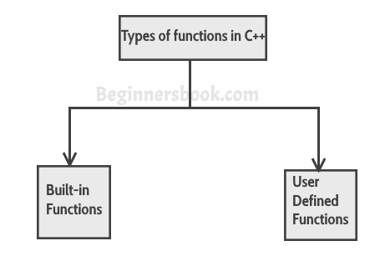
Types of function
We have two types of function in C++:

Slide 83
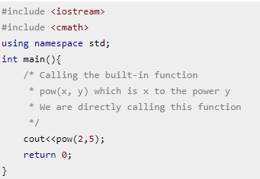
Build-it functions
Built-in functions are also known as library functions. We need not to declare and define these functions as they are already written in the C++ libraries such as iostream, cmath etc. We can directly call them when we need.
example: C++ built-in function example:
Here we are using built-in function pow(x,y) which is x to the power y.
This function is declared in cmath header file so we have included the file in our program using #include directive.

Slide 84
User-defined functions
We have already seen user-defined functions, the example we have given at the beginning of this tutorial is an example of user-defined function.
The functions that we declare and write in our programs are user-defined functions.

Slide 85
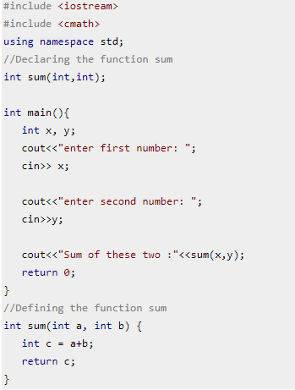

Slide 86
Default Arguments in C++ Functions
The default arguments are used when you provide no arguments or only few arguments while calling a function. The default arguments are used during compilation of program.
For example, lets say you have a user-defined function sum declared like this: int sum(int a=10, int b=20), now while calling this function you do not provide any arguments, simply called sum(); then in this case the result would be 30, compiler used the default values 10 and 20 declared in function signature.
If you pass only one argument like this: sum(80) then the result would be 100, using the passed argument 80 as first value and 20 taken from the default argument.

Slide 87

Rules of default arguments
It is up to you to assign default values to all arguments or only selected arguments but remember the following rule while assigning default values to only some of the arguments:
If you assign default value to an argument, the subsequent arguments must have default values assigned to them, else you will get compilation error.

Slide 88


